Slide 1
NUTS Alumni Event 13 May 2025
Tia Nutters, t.nutters@rug.nl
Funding Officer
Faculty of Spatial Sciences
Faculty of Religion, Culture and Society

Slide 2
Current jobs and career path
Advice based on what I have learned
Any specific tips or insights

Slide 3
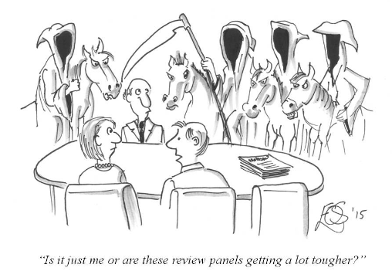

Current jobs
Funding officer
  Research support context
  Research grants and prizes
  Main tasks: advising, editing and writing
Member of the Advisory Board to the Dutch Foundation for Literature

Slide 4
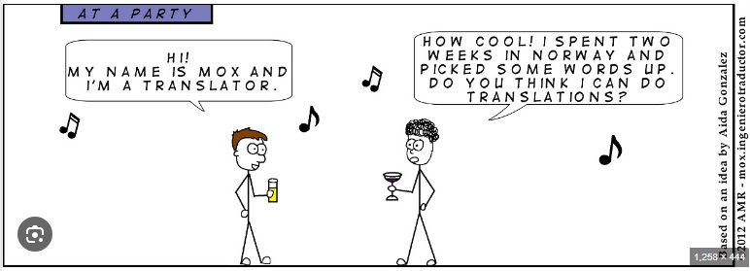
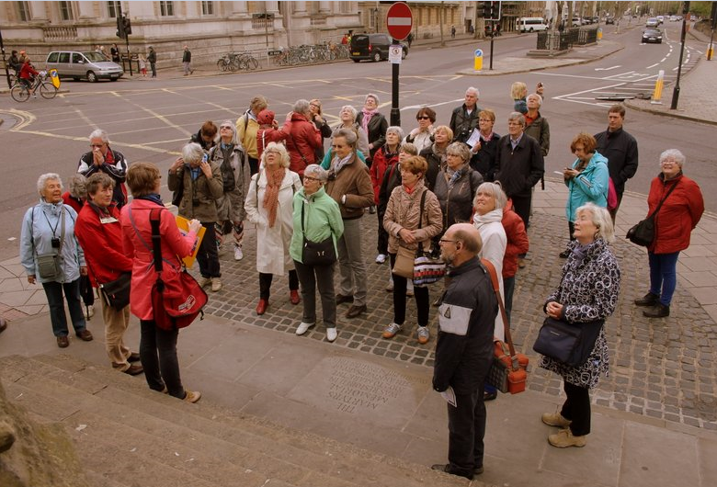
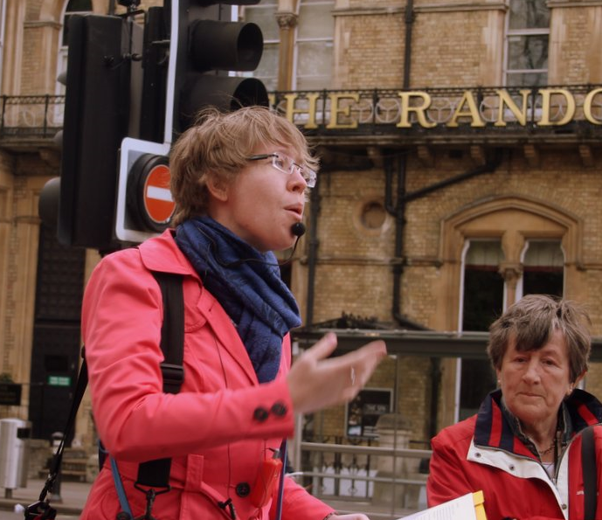
Career path
The ‘Dora the Explorer’ phase
The ‘Paw Patrol’ phase
The ‘Ninjago’ phase

Slide 5
Advice based on what I learned
Content and quality vs procedures
Language matters
Working with people vs working with texts
Degree of autonomy
Life-long learning

Slide 6

Specific tips or insights
Talk about earnings
Do not underestimate your own qualities
Hudson Christie for The New Yorker (27/2/2023)

